Slide 1


Investigating Potential Martian Biocrust
Maezy Biemond

Slide 2
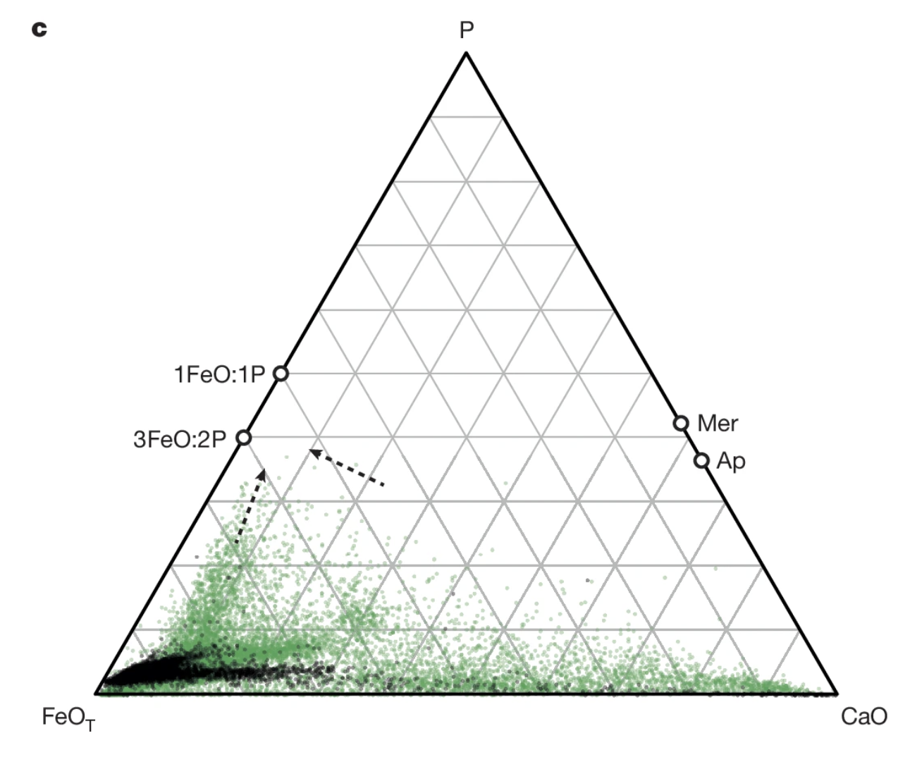
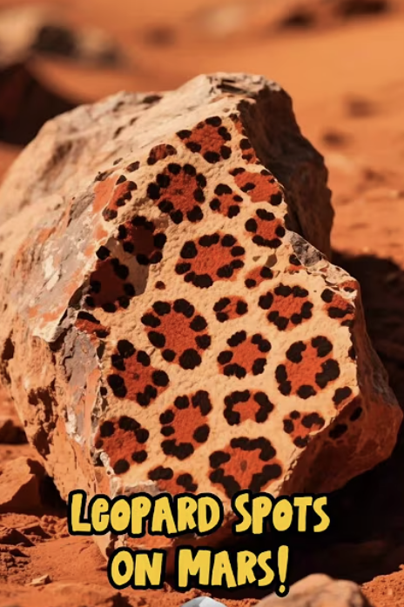

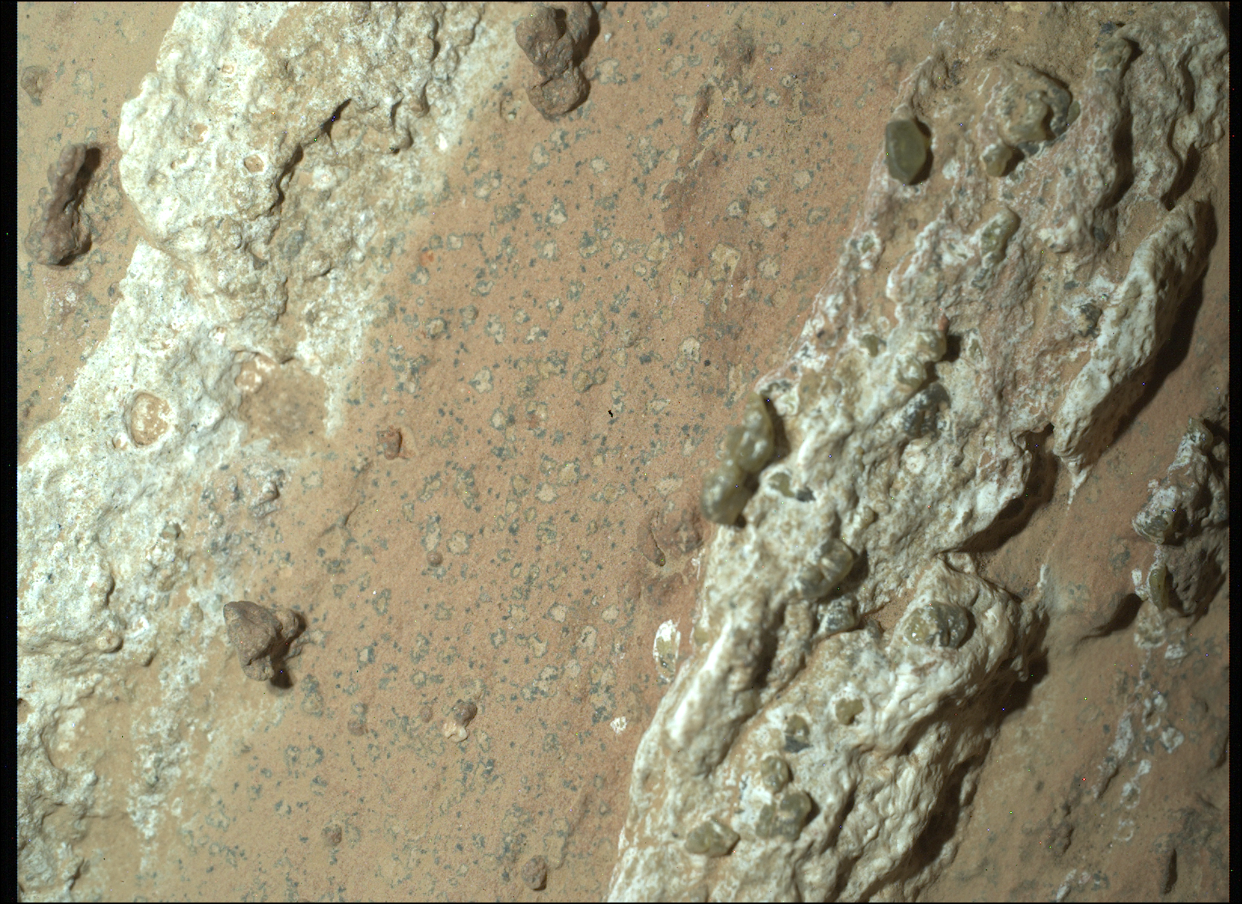
NASA’s Discovery
“Here we report a geochemical survey and show organic-carbon-bearing mudstones in the Bright Angel formation_{1.}”
“PIXL micro-X-ray fluorescence (XRF) elemental analyses indicate that Bright Angel formation mudstone is rich in Silicone, Aluminum and Iron._{1.}”
Hurowitz, Joel A., et al. “Redox-Driven Mineral and Organic Associations in Jezero Crater, Mars.” Nature News, Nature Publishing Group, 10 Sept. 2025, www.nature.com/articles/s41586-025-09413-0.

Slide 3

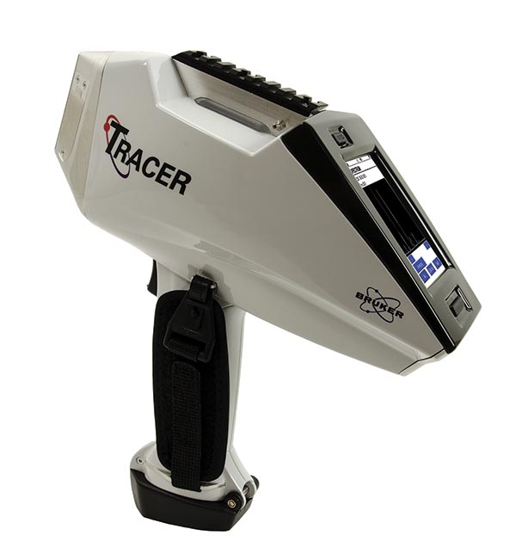
What is XRF?
XRF (X-ray fluorescence) is a non-destructive analytical technique used to determine the elemental composition of materials. _{2.}
2. Ask A Scientist S. “What Is XRF (X-Ray Fluorescence) and How Does It Work?” Ask a Scientist, 25 Mar. 2020, www.thermofisher.com/blog/ask-a-scientist/what-is-xrf-x-ray-fluorescence-and-how-does-it-work/.

Slide 4
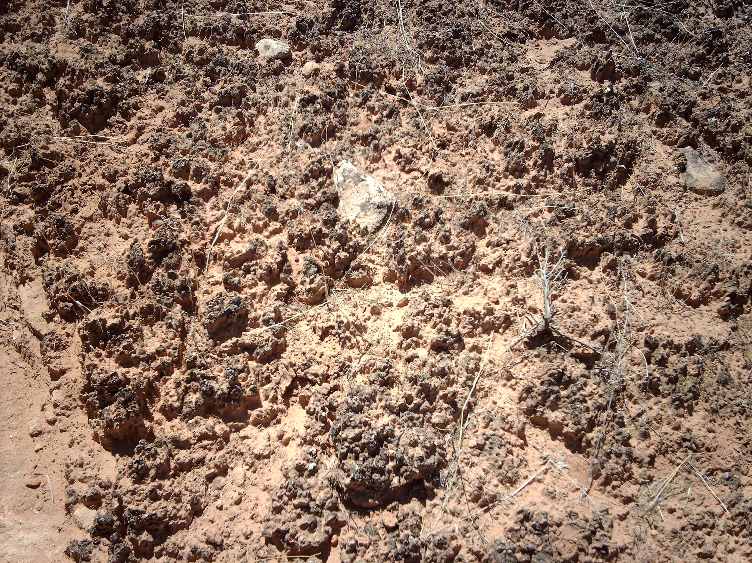
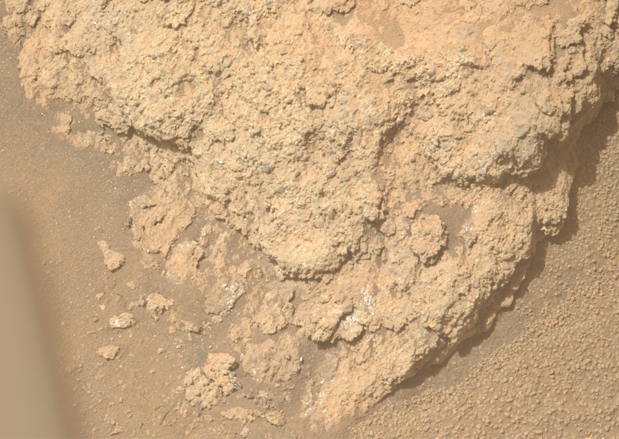
What is Biocrust?
Biocrusts (specifically cyanobacteria) are one of the oldest known life forms and can consist of mosses, cyanobacteria, lichens, algae, and microfungi._{3.}
Biological soil crusts (biocrusts) are commonly found on the soil surface in arid and semi-arid ecosystems (collectively called drylands)._{3.}
Martian Biocrust?
3. Southwest Biological Science Center. Biological Soil Crust (“Biocrust”) Science | U.S. Geological Survey, www.usgs.gov/centers/southwest-biological-science-center/science/biological-soil-crust-biocrust-science. Accessed 24 Mar. 2026.

Slide 5
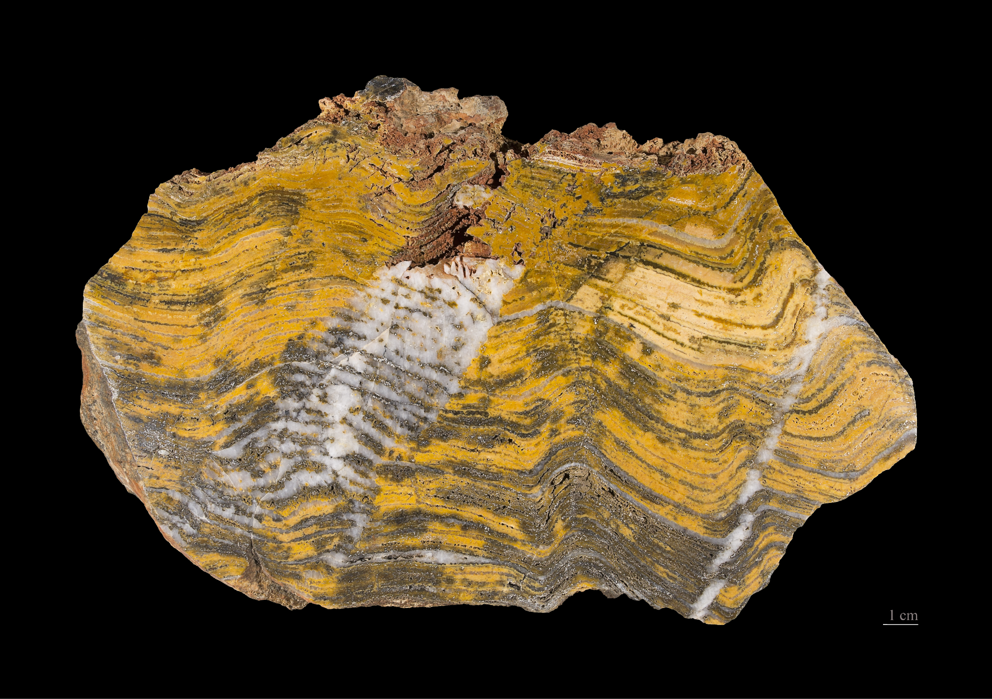
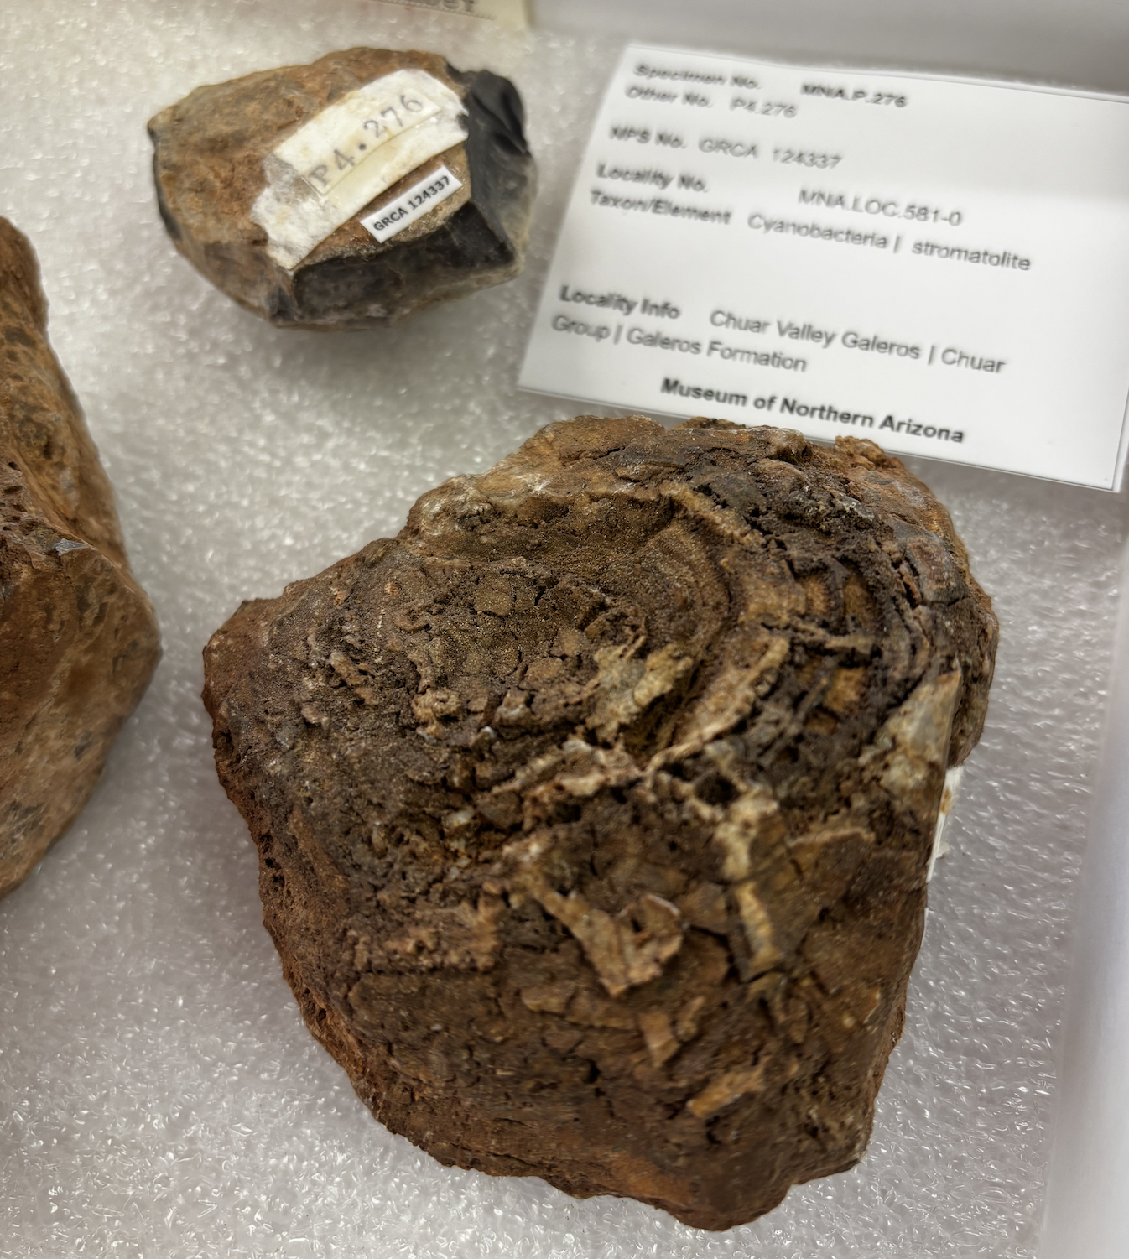
What is a Stromatolite
Fossilized biocrust samples would have been ideal but we were granted access to use stromatolites instead.
Stromatolites are found back as far as 3.5-3.7 billion years ago in the geological record.
4.
4. “Stromatolite.” Wikipedia, Wikimedia Foundation, 16 Mar. 2026, en.wikipedia.org/wiki/Stromatolite.

Slide 6
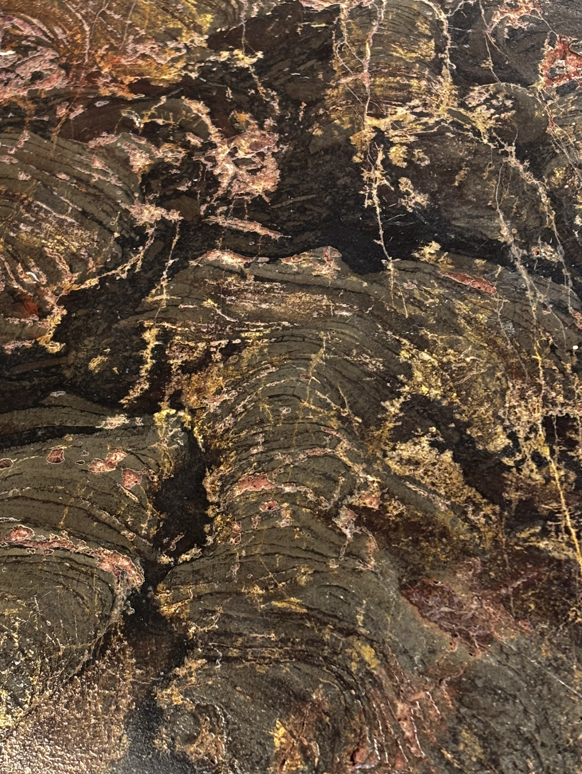
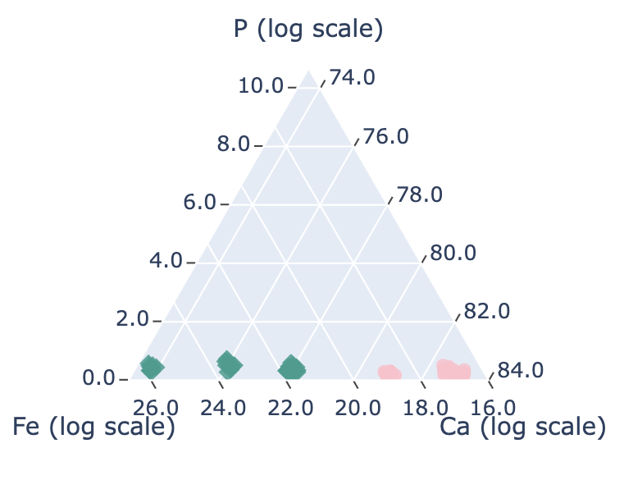
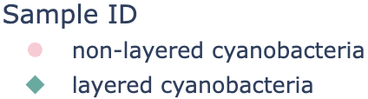
The Golden Sample
matrix
layered stromatolite

Slide 7
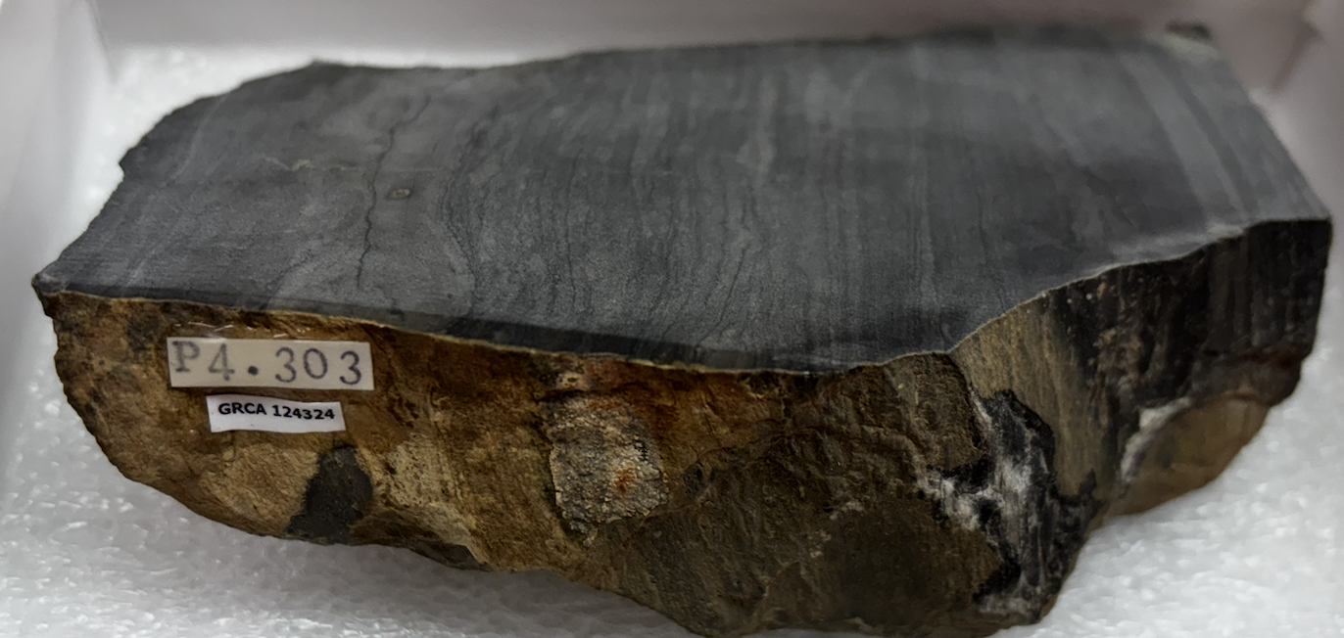
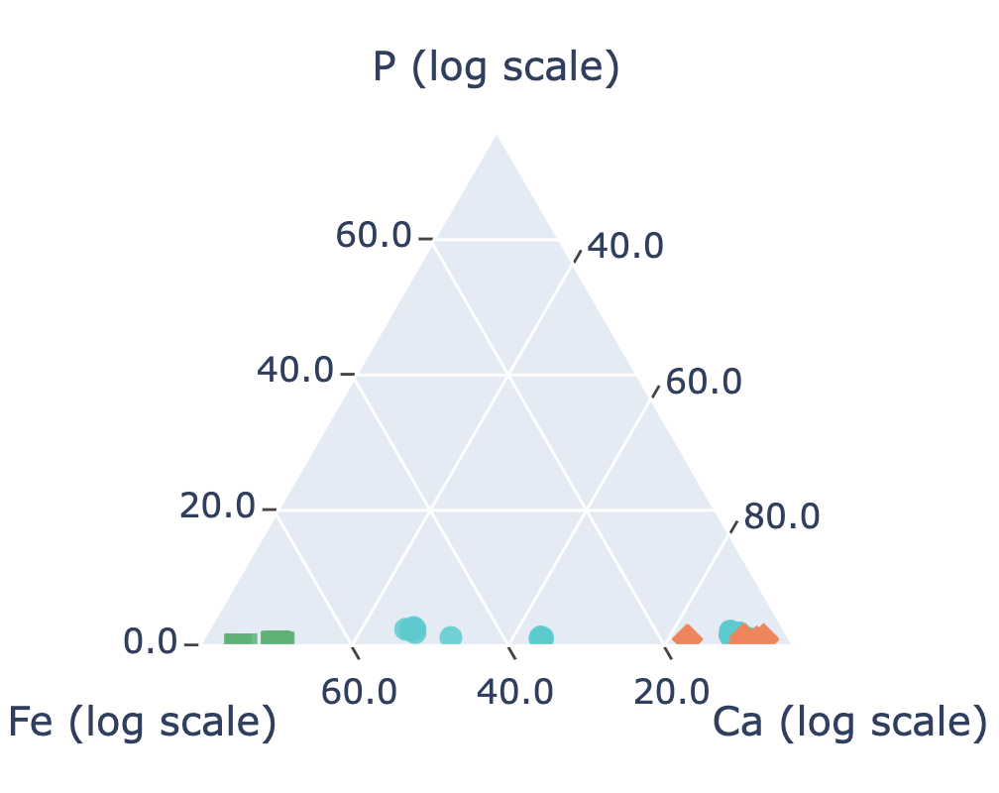

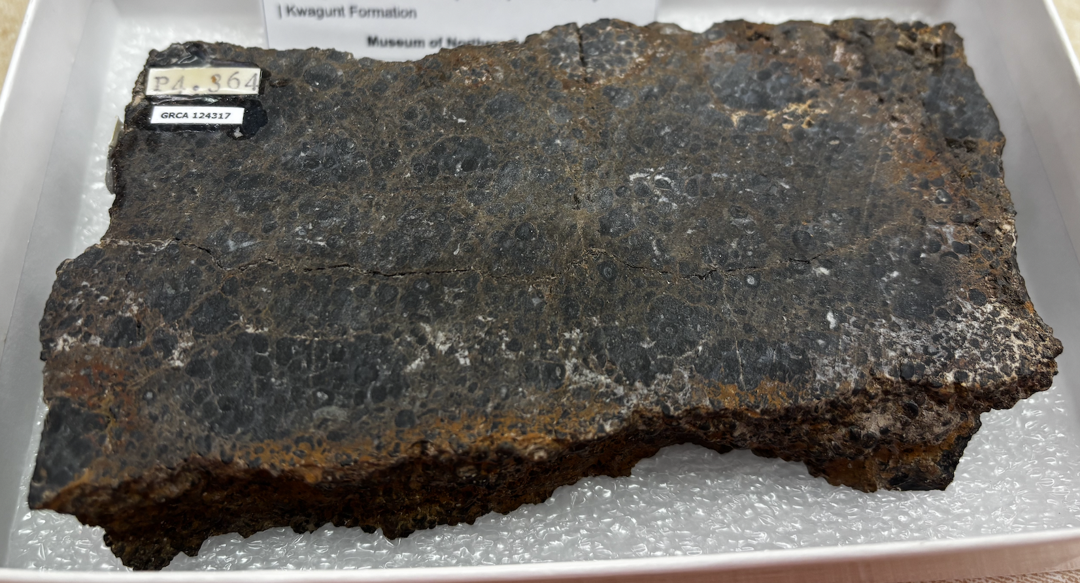
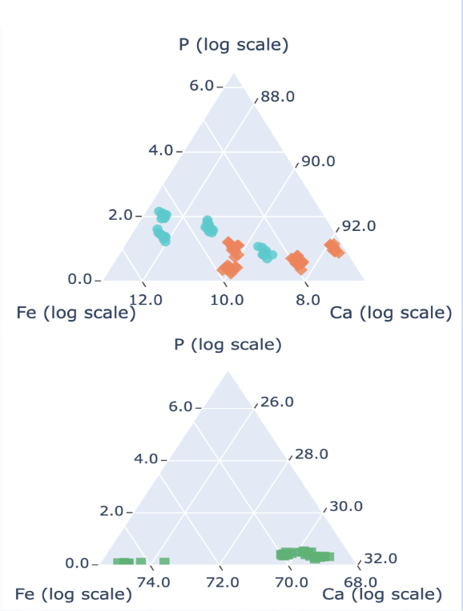
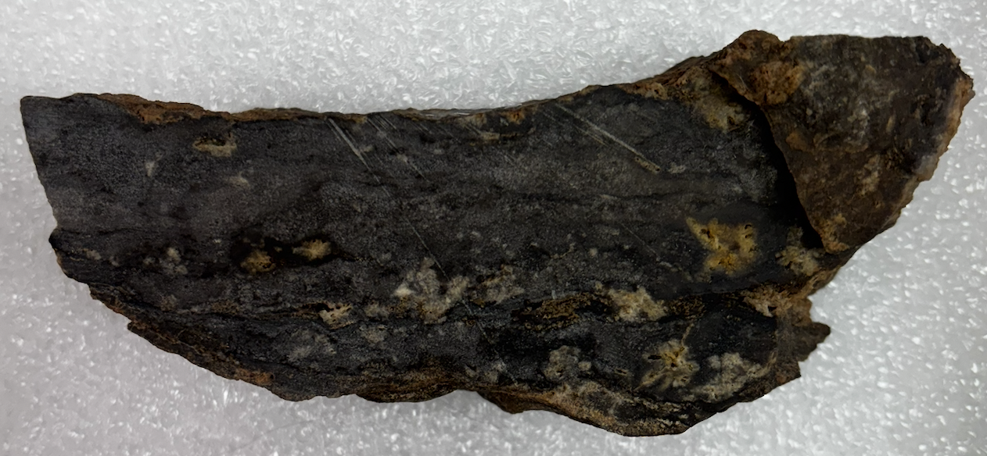
Control Samples

Slide 8
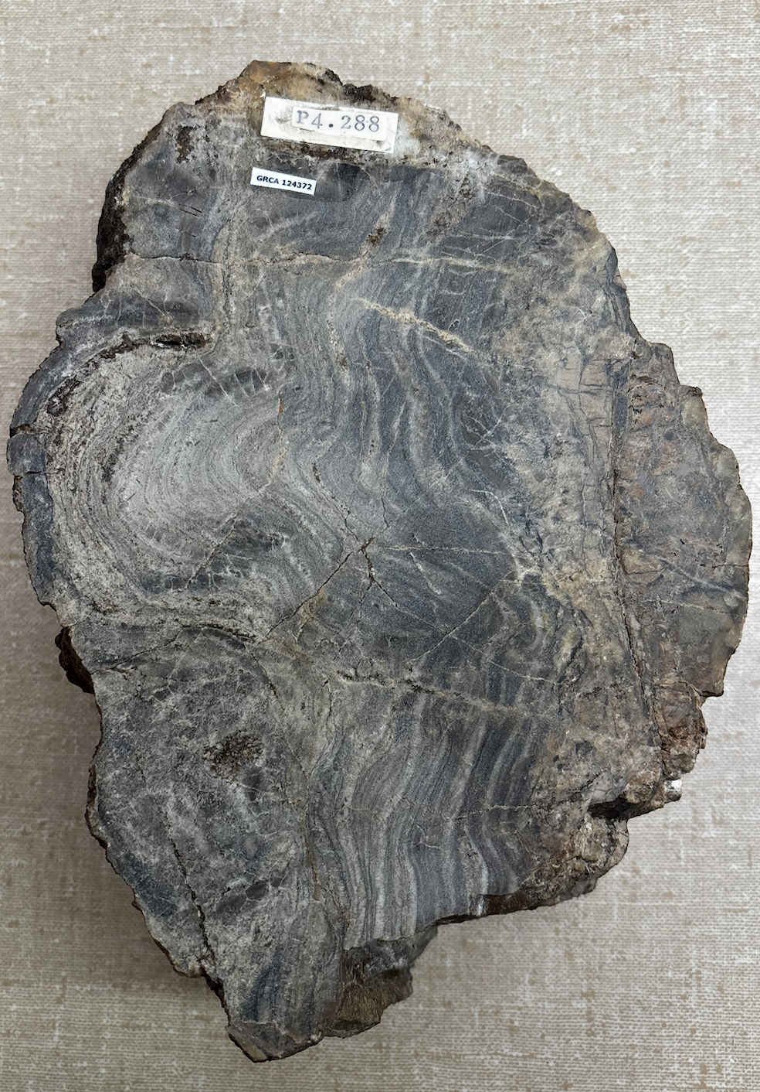
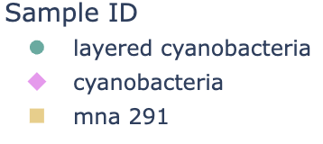
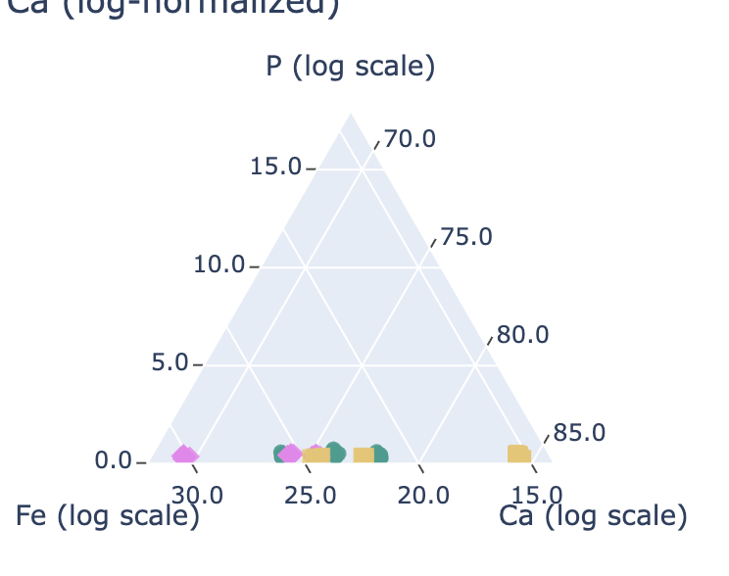
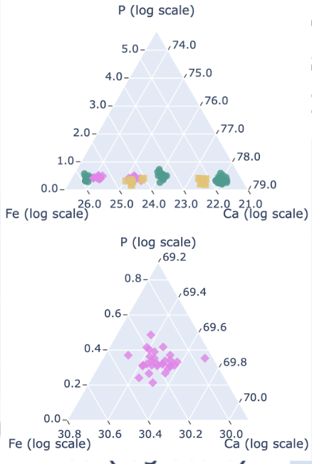
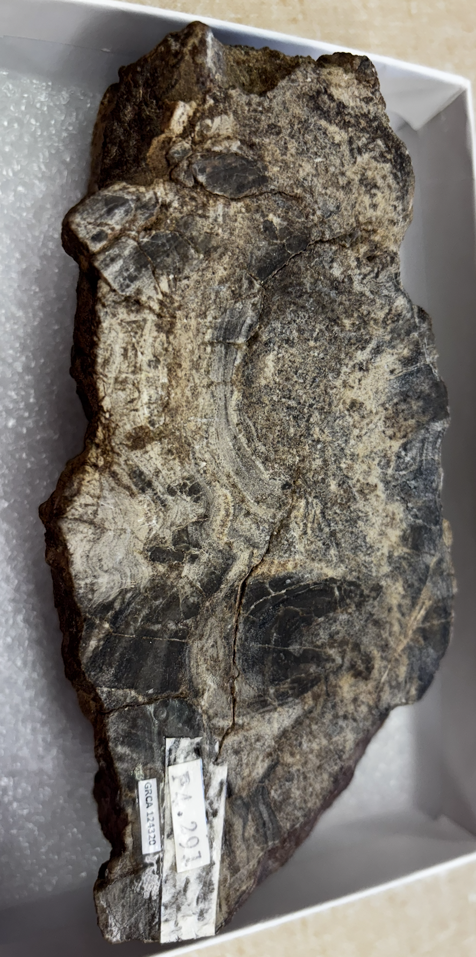
Confirmed Stromatolite Samples
mna 383
mna 383
mna 288

Slide 9
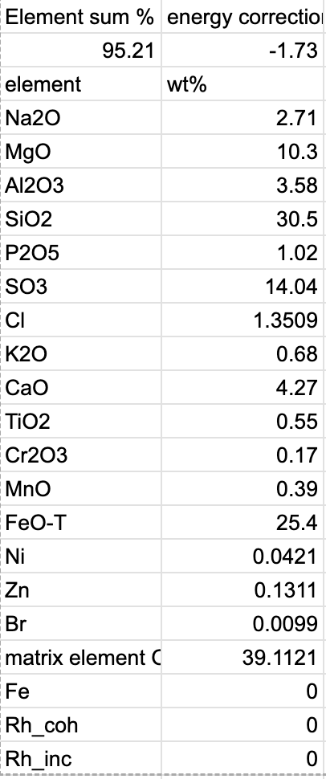
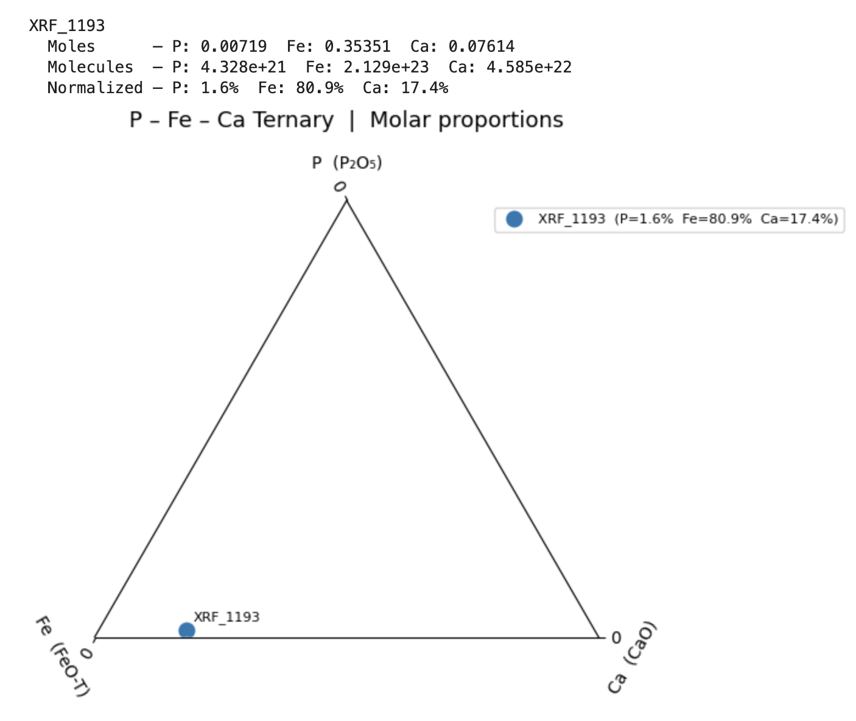
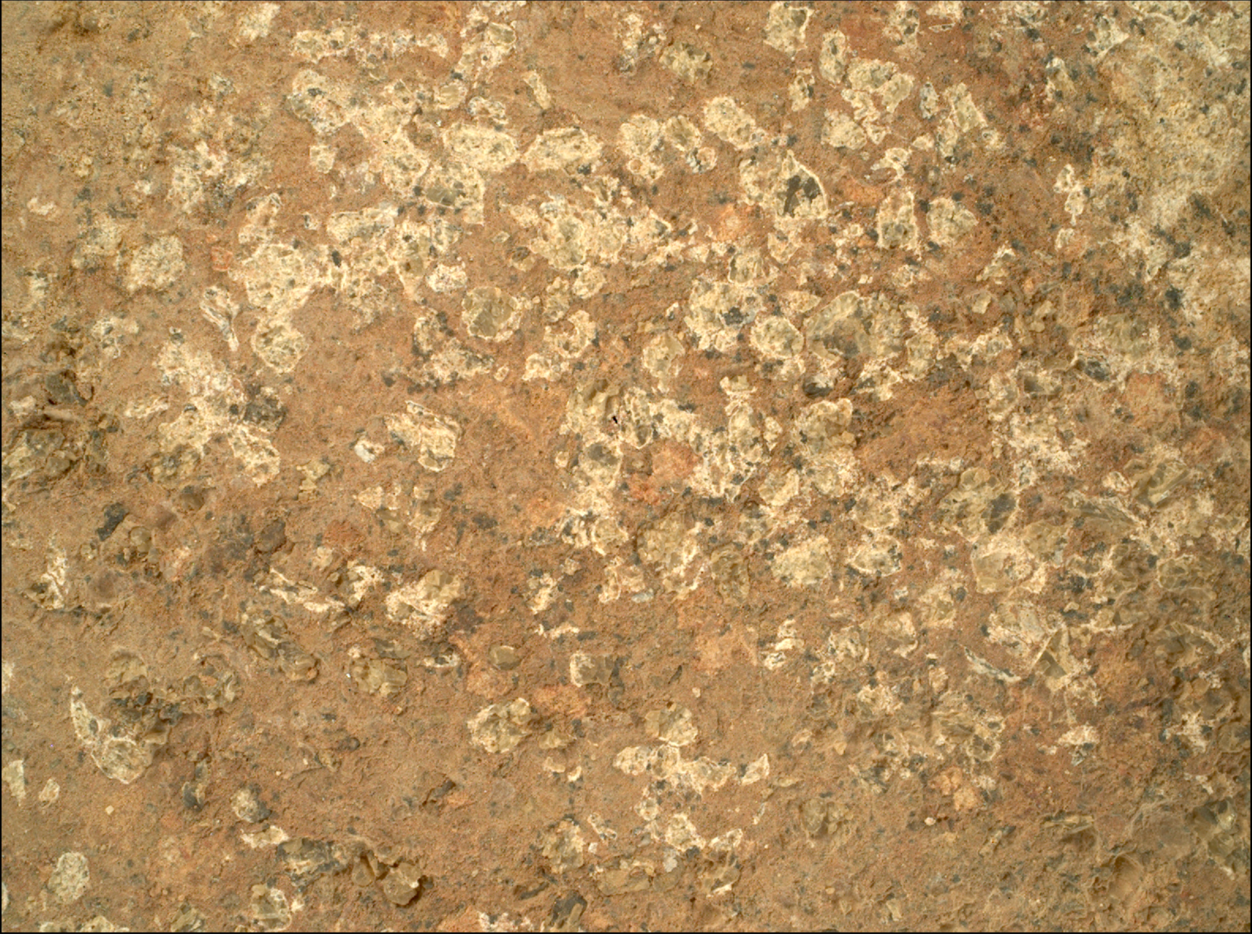
Potential Martian Leopard Spots?
Sol 1193

Slide 10
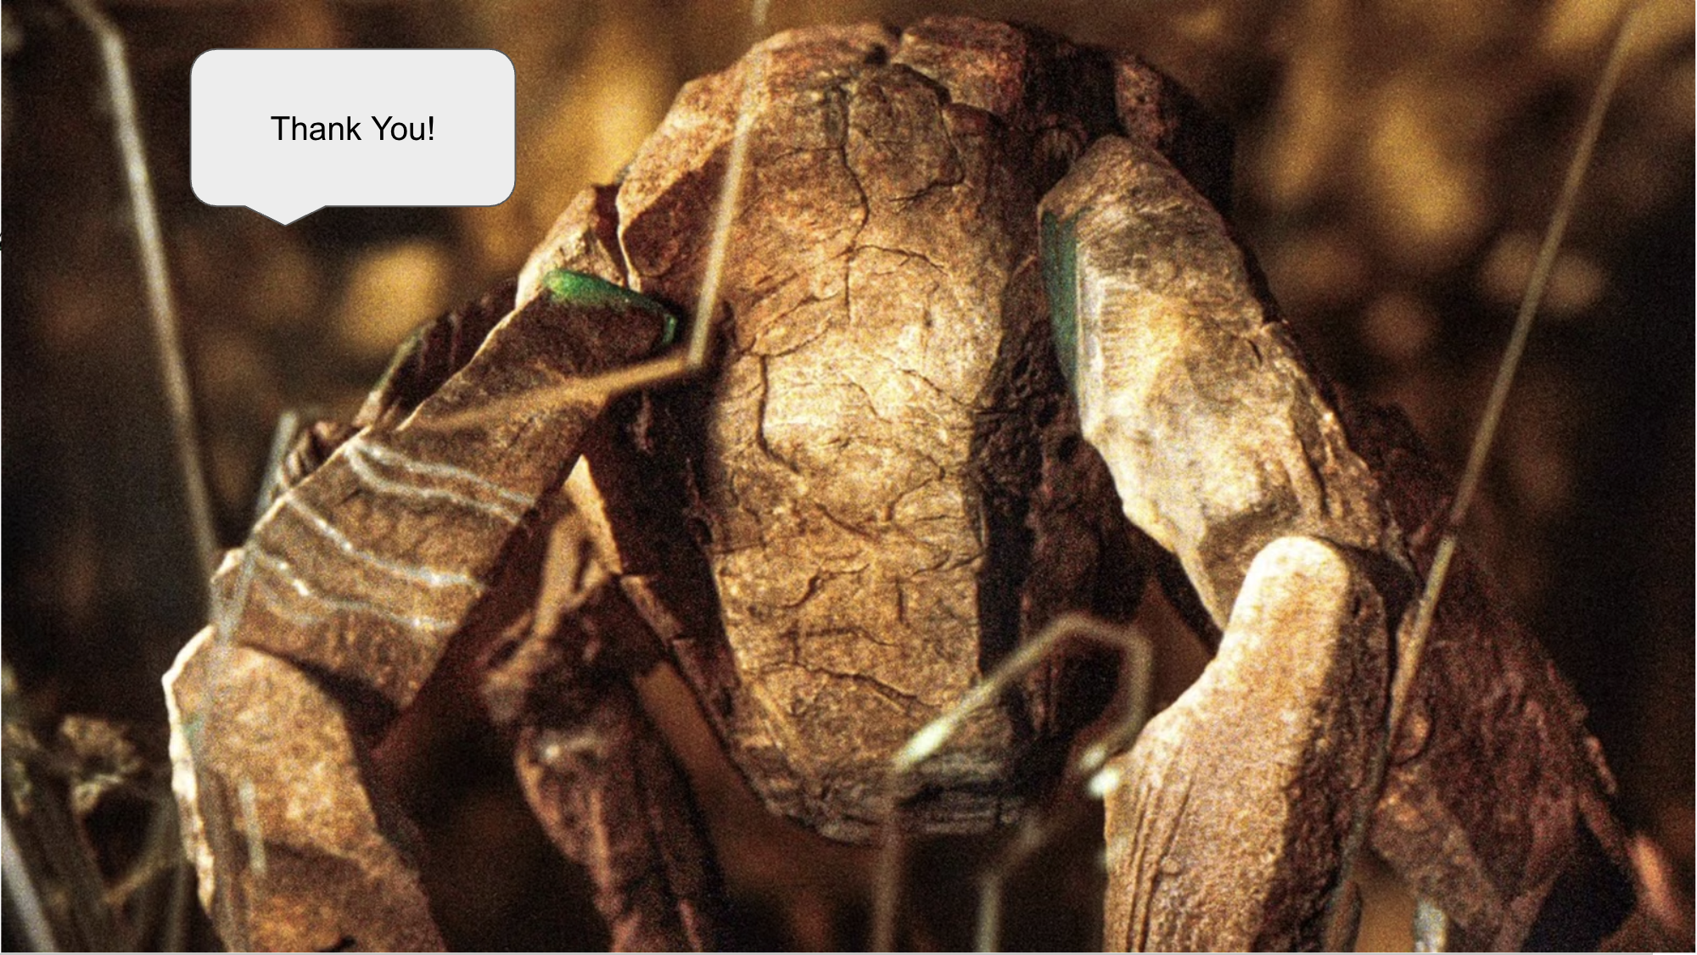
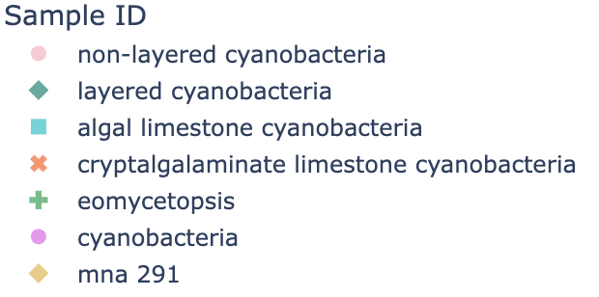
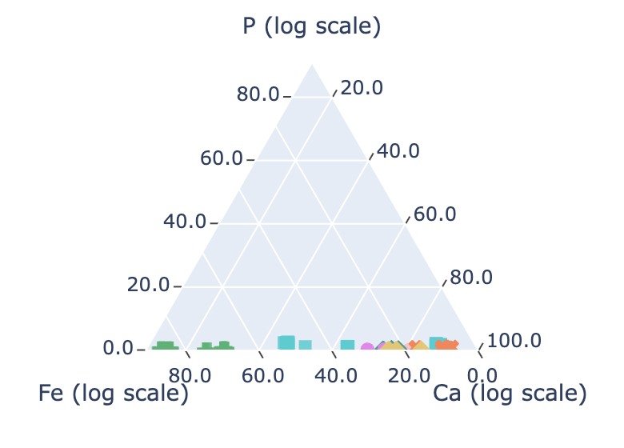
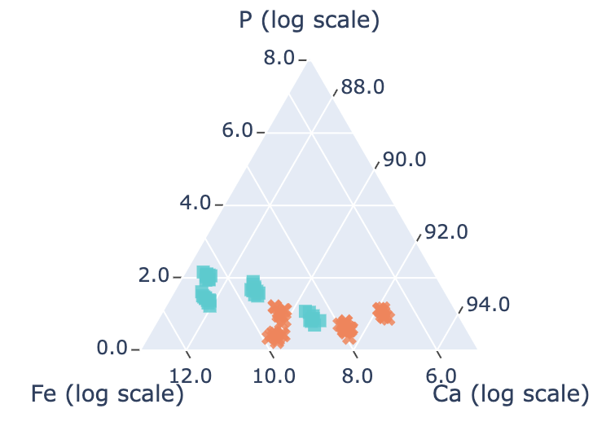
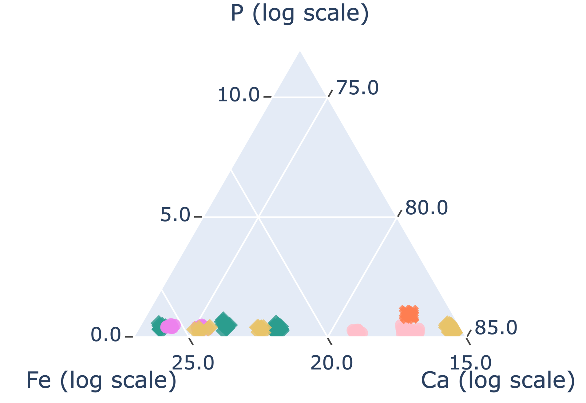
All of the data together
matrix
layered stromatolite
Analyzed both stromatolite and non-stromatolite samples in terms of Phosphorus, Iron and Calcium
Compared XRF data with NASA XRF data
Identified potential martian leopard spots in Bright Angel Formation
mna 288

